Slide 1
Samia Niha MSc Bioinformatics Supervisors: Prof Hans Reul, Dr Karen Mifsud
Corticosteroid Receptor-Genome Interaction and Its Epigenetic Regulation Under Physiological Conditions in the Rat Hippocampus
Notes:
Good afternoon. My project explores how the glucocorticoid and mineralocorticoid receptors interact with the genome in the rat hippocampus under different physiological conditions, and whether chromatin accessibility plays a role in shaping these interactions."

Slide 2
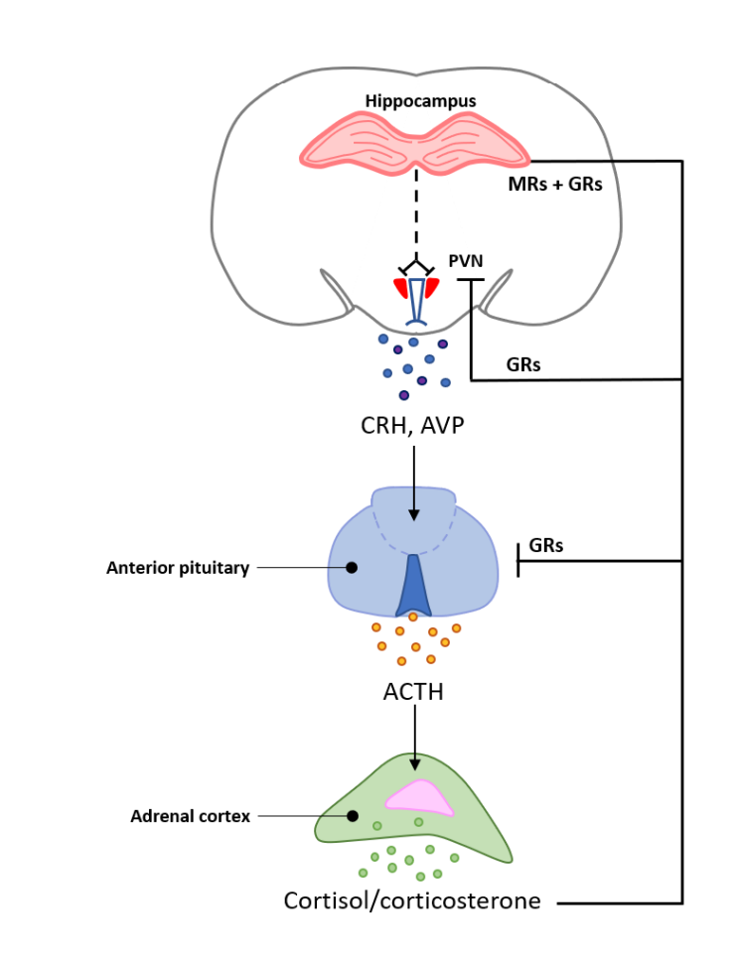
Corticosteroid Signalling in the Hippocampus
Condition | GC Level | Biological Context
BLAM | Low | Morning Baseline
BLPM | Moderate | Afternoon circadian peak
FS30 | Very High | Acute stress (forced swim)
H3K9acS10p = active chromatin mark “May regulate GR/MR access to DNA under different GC conditions”
Notes:
“Glucocorticoid hormones — or GCs — regulate stress and circadian rhythms by binding to two key transcription factors in the brain: the mineralocorticoid receptor (MR) and the glucocorticoid receptor (GR). These receptors bind DNA and regulate gene expression in a condition-dependent way — with MR more active at low GC levels, and GR more responsive at higher levels like those seen during stress. In the hippocampus, MR and GR binding patterns vary across physiological states. Prior work by Mifsud et al. (2021) used ChIP-seq to analyse their binding in three conditions: morning baseline (BLAM), late-afternoon baseline (BLPM), and post-stress (FS). However, the direct comparison between BLPM and FS — that is, circadian peak versus acute stress — has not been done. This distinction is critical for understanding how stress-specific transcriptional responses differ from normal daily variation. In addition, chromatin state — particularly the presence of H3K9acS10p, a histone mark associated with open, active DNA — may help regulate MR and GR binding. Whether this epigenetic marker contributes to differences between FS and BLPM remains unexplored — and forms part of the focus of my project.
“Glucocorticoid hormones — or GCs — are steroid hormones released in response to stress and as part of our daily circadian rhythm. In the brain, they work by binding to two key transcription factors: the mineralocorticoid receptor (MR) and the glucocorticoid receptor (GR). These receptors are proteins that bind DNA and regulate gene expression. MR is active at low GC levels, while GR responds more strongly when GC levels rise — such as during stress. The hippocampus is highly sensitive to these hormones. While previous studies compared morning baseline to other conditions, my project focuses on the direct comparison between stress (FS) and circadian peak (BLPM). I also investigated H3K9acS10p, a chromatin modification that marks open, transcriptionally active DNA, to see whether epigenetic factors regulate GR and MR binding.”

Slide 3
MR and GR bind distinct gene sets under stress (FS) vs circadian (BLPM) conditions, influenced by chromatin accessibility, particularly H3K9acS10p enrichment.
Key Objectives
Characterise condition-specific MR and GR binding in the rat hippocampus
Investigate whether H3K9acS10p enrichment correlates with receptor binding
Distinguish stress-induced gene regulation from circadian-driven patterns
Identify genomic regions and genes selectively targeted in FS vs BLPM
Explore functional relevance of differentially bound genes via pathway analysis
Hypothesis
Notes:
Slide 3 – Hypothesis & Objectives
Script: My hypothesis is that MR and GR interact with different gene regions depending on whether glucocorticoids are elevated through normal circadian rhythm or acute stress — and that chromatin accessibility, marked by H3K9acS10p, helps regulate this. To address this, my objectives were to identify where MR and GR bind under BLPM and FS, assess how H3K9acS10p overlaps with these sites, and interpret how this might influence gene regulation. Ultimately, I aimed to distinguish stress-specific transcriptional effects from normal circadian patterns and explore their potential biological relevance.”

Slide 4
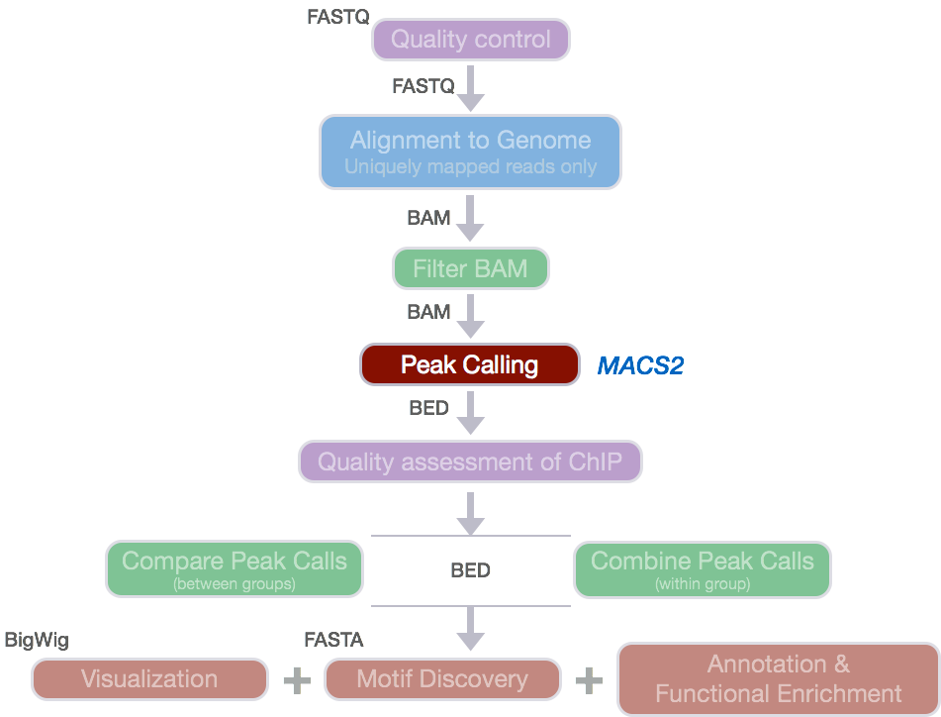

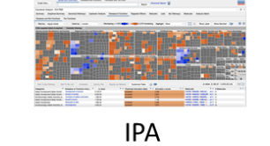
Method
Chip-seq data
(MR,GR,S10)
Quality Control
(FastQC)
Peak calling (MACS2)
Differential binding analysis (DiffBind)
Methods Pipeline
Peak annotation (ChIPseeker)
Visualisation (PCA, heatmap, MA, Volcano plots.
Separate Diffbind for Venn Diagram Visualisation
Filtering & IPA gene list preparation
Functional enrichment (IPA / GO)
Project write up
Notes:
I reanalysed ChIP-seq datasets for MR, GR, and H3K9acS10p in the rat hippocampus under circadian and stress conditions. After quality control and peak calling with MACS2, I performed differential binding analysis using DiffBind. I annotated significant peaks with ChIPseeker and formatted gene lists using R. To visualise binding trends and assess replicates, I generated PCA plots, heatmaps, MA plots, and volcano plots. Next, I’ll generate Venn diagrams to compare overlap in target genes across MR, GR, and H3K9acS10p. Finally, I’ll carry out pathway enrichment using IPA or GO analysis to interpret the biological relevance of condition-specific targets.

Slide 5
Results Summary
MR
S10: heatmap shows slight clustering
GR: Strong Differential binding, including FKKBP5.
MR: Moderate Separation of conditions
Notes:
The GR volcano plot shows a strong stress response, with 186 significant peaks. Many are enriched in FS, including FKBP5, a well-known GR target — supporting both biological and technical validity.
MR had just 11 significant peaks, but the PCA plot still shows some condition-based separation, suggesting a subtler role.
For H3K9acS10p, the heatmap shows limited clustering and only 9 significant peaks, but FKBP5 was again present — which points to localised chromatin priming rather than widespread accessibility change.

Slide 6
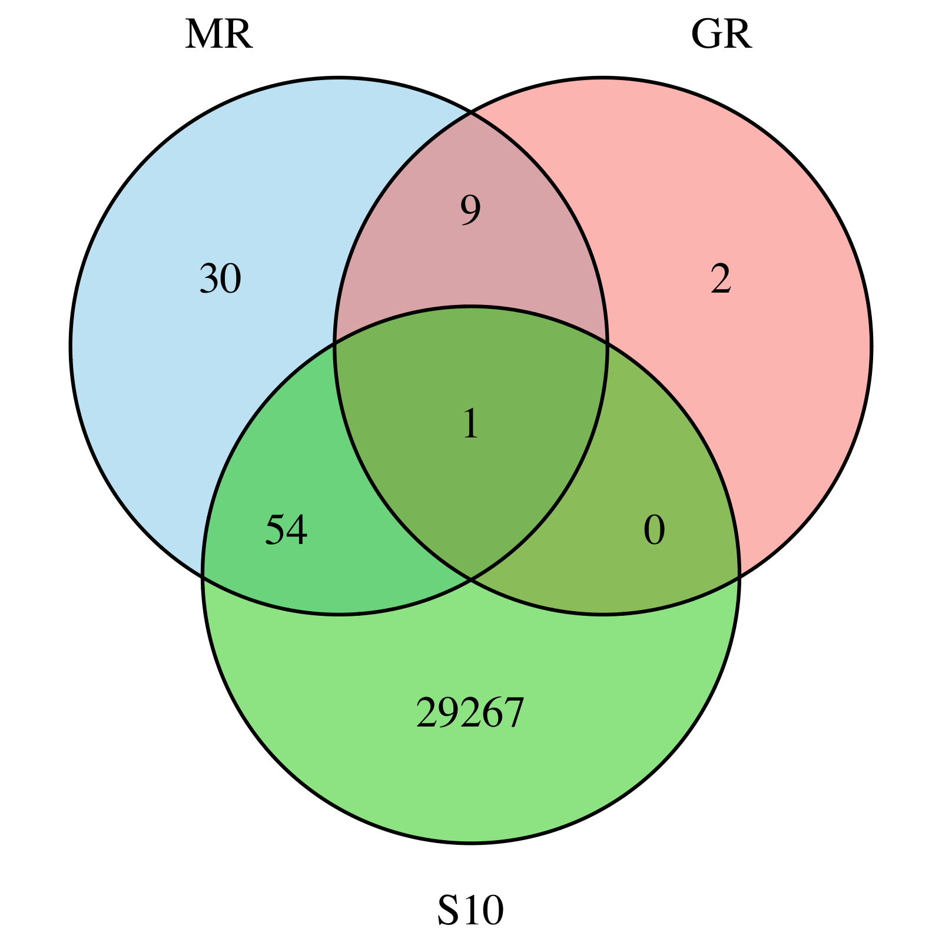
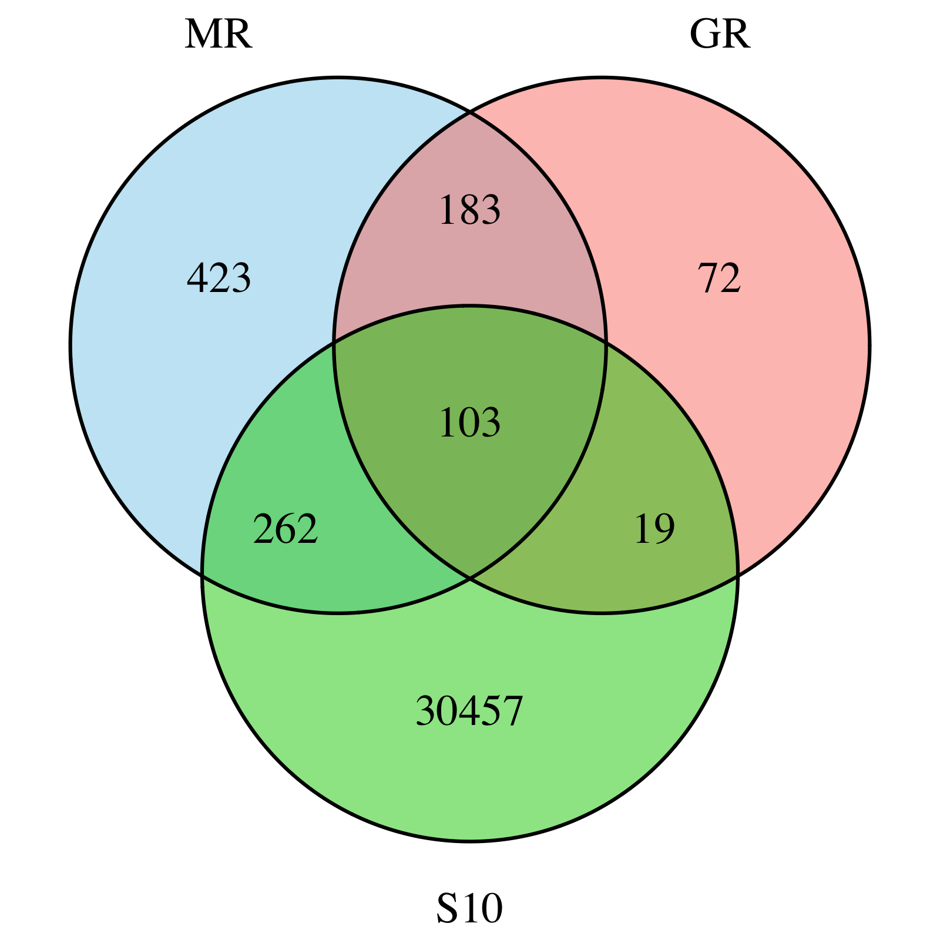
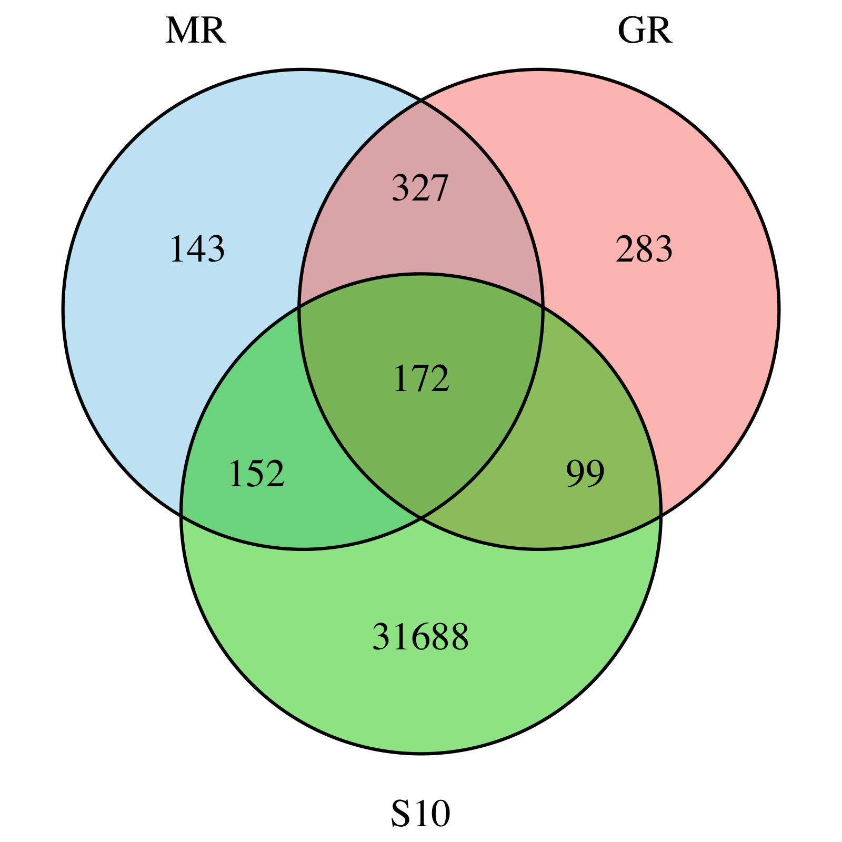
BLAM
Venn Diagram Analysis: Shared Binding Across Conditions
BLPM
FS
Very limited overlap at BLAM → reflects low receptor activity
Highest triple overlap at FS → strong, coordinated stress response
Moderate overlap at BLPM → possible circadian regulation
Notes:
Here I used Emily’s approach to generate Venn diagrams comparing GR, MR, and S10 binding across conditions. At BLAM, almost no triple overlap is seen — confirming this low-GC state has accessible chromatin but little receptor activity. Under stress (FS30), we see the highest triple overlap, including 103 shared peaks — consistent with coordinated GR and MR binding at accessible loci. At BLPM, overlap remains but GR begins to diverge, showing more unique peaks. These patterns reinforce that GR is most dynamic under stress, and S10 likely helps prime certain loci for receptor binding.”
At BLAM, overlap between GR, MR, and S10 is minimal — just one shared peak — consistent with a low-activity baseline. At FS, overlap increases dramatically, with over 100 peaks shared across all three factors. This suggests a strong, coordinated stress response where receptors bind accessible chromatin regions. At BLPM, overlap remains high, but GR shows more unique binding, which may reflect circadian-specific targets. Overall, these results support the idea that GR is most dynamic under stress, and that **chromatin accessibility likely plays a role in enabling that response at specific loci.

Slide 7
Interpretation & Reflection
Key Insight
GR shows clear stress-driven binding at FS (186 peaks)
MR binding stronger at BLPM, supporting circadian regulation
S10 stable overall, but overlaps GR at FKBP5 in FS
FS-specific overlap (103 GR–MR–S10 peaks) reflects coordinated stress response
Suggests receptor access is guided by chromatin priming at stress loci
Metric | GR | MR | H3K9acS10p (S10)
Volcano plot peaks (FDR < 0.05) | 186 | 11 | 9
PCA separation | Strong | Moderate | Weak
FKBP5 present | Yes | No | Yes
Reuleaux triangle overlap (GR+MR+S10) | 103 | 103 | 103
Biological role | Stress-responsive | Circadian/stable | Chromatin accessibility
Notes:
Taking all the data together, we see a clear pattern emerge. GR binding was strongly stress-responsive, with 186 significant peaks and clear FS vs BLPM separation in the PCA. MR binding also shifted under stress, though more modestly, in line with its higher basal occupancy. Interestingly, S10 showed weak global separation, but still overlapped with GR at key loci like FKBP5. The Venn diagrams reinforce this: FS had the highest number of MR-GR-S10 triple overlaps, pointing to stress-specific co-regulation. At BLPM, the MR-only and MR-S10 overlaps were more prominent, consistent with a circadian accessibility model. These results align well with both Emily’s and Hans’ findings, suggesting that chromatin accessibility via H3K9acS10p modulates receptor binding in a locus- and condition-specific manner.

Slide 8
Conclusions & Future Work
GR shows targeted, stress-induced binding at FS
MR appears more stable, with stronger signal at BLPM
S10 overlaps GR at key loci, suggesting chromatin priming
FKBP5 reflects how receptor binding and accessibility intersect
Reinforces Hans model of stress-modulated receptor action
Notes:
This project adds to the growing understanding that transcriptional responses to stress are not only receptor-specific, but also shaped by the chromatin environment. Hans Reul’s paper highlighted GR’s dominant role under acute stress — my results reinforce this, with GR binding focused and condition-specific. In contrast, MR appears to provide a more continuous, possibly permissive signal, as suggested in Emily Price’s work. Although H3K9acS10p didn’t shift dramatically between FS and BLPM, its presence at key genes like FKBP5 supports the idea of epigenetic priming — where chromatin is kept in a ‘ready’ state for GR to act. My next steps are to run pathway analysis using IPA and complete the report, where I’ll integrate these findings with what we know about hippocampal stress signalling and epigenetic regulation.”

Slide 9
Q&A
Why does FS show stronger GR/MR/chromatin overlap than BLPM?
So FS is a strong stress condition, and that causes a sharp rise in circulating glucocorticoids. That sudden increase activates both GR and MR at the same time, which seems to lead to more coordinated binding across accessible regions. In my Venn diagrams, this came through as the highest overlap across GR, MR, and S10 under FS. In contrast, BLPM reflects the normal circadian peak in glucocorticoids, so the activation is more gradual. MR seems to dominate in that condition, and GR is less strongly engaged — so there’s less overlap overall. Basically, FS triggers a more unified stress response, which probably explains why we see that pattern of increased co-binding.
Why do you think most S10 peaks don’t show receptor binding, even though GR and MR often bind at S10-enriched sites?”
That’s a great question — it touches on how chromatin accessibility works in gene regulation. H3K9acS10p is known to mark open, active chromatin, so it sets the stage for binding, but it doesn’t guarantee it. In my analysis, I found that a lot of GR and MR peaks overlapped with S10, especially under FS — which makes sense. But the reverse wasn’t true: most S10 regions didn’t show any receptor binding. That suggests S10 acts more like a permissive mark — it shows where the chromatin is accessible, but for binding to actually happen, you still need other things in place — like hormone signalling, the right DNA motifs, or co-factors. So I’d say S10 helps make binding possible, but it’s not enough on its own to drive receptor recruitment.

